Slide 1
Neo4j
By Altotech

Slide 2
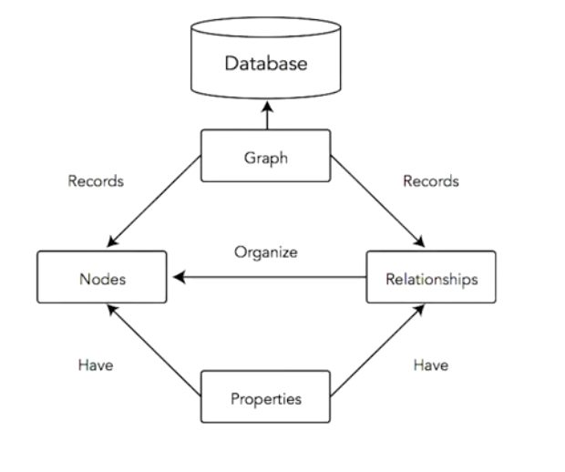
What is a Graphing Database?

Slide 3
What is a Graphing Database?
Relation
Node A
Node B

Slide 4
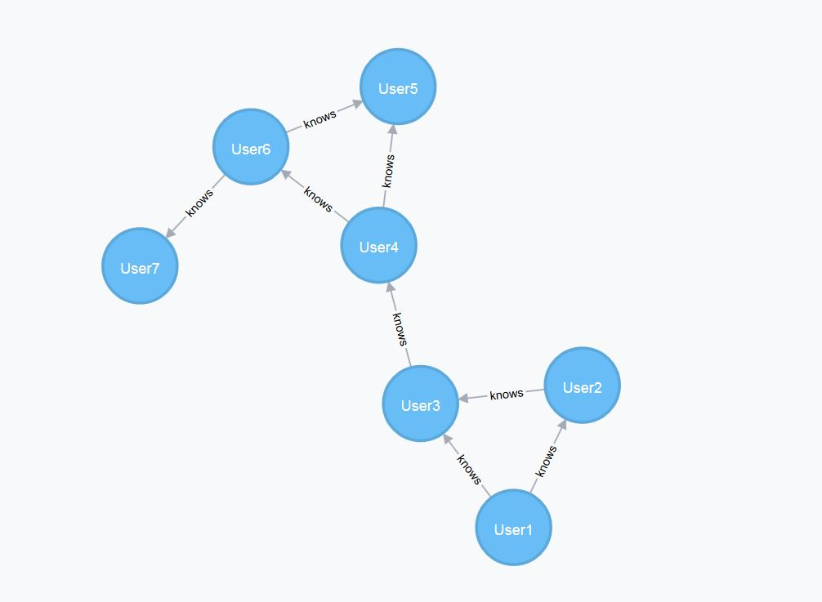
What is a Graphing Database?

Slide 5
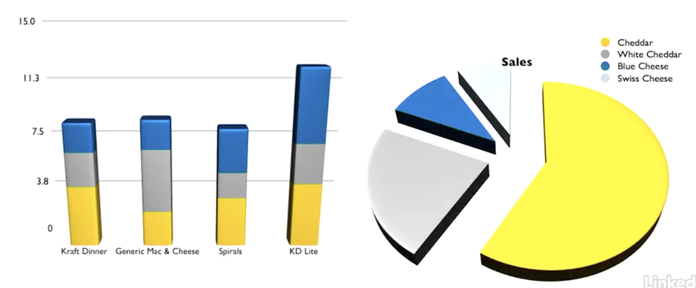
Type of Mac & Cheese Eaten by Canadians

Slide 6
Type of Mac & Cheese Eaten by Canadians

Slide 7
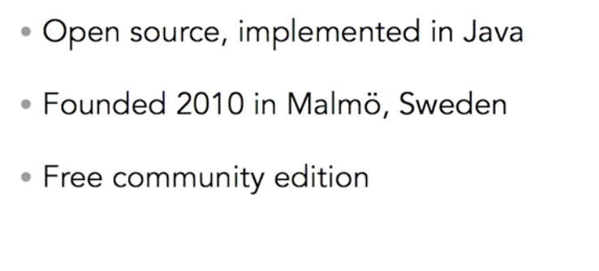
Neo4j History

Slide 8
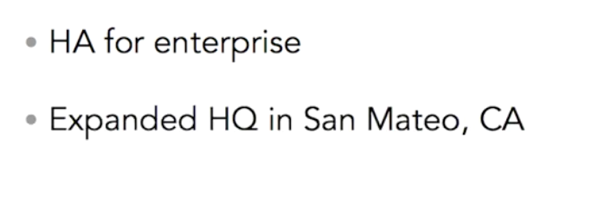
Neo4j History

Slide 9
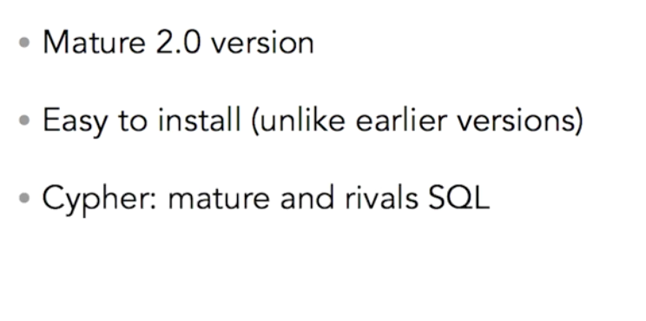
Current State of Neo4j

Slide 10
Neo4j technology

Slide 11
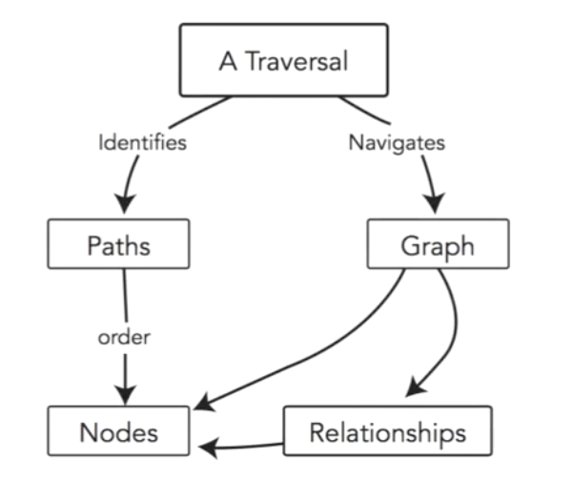
Graphing Database Concepts

Slide 12
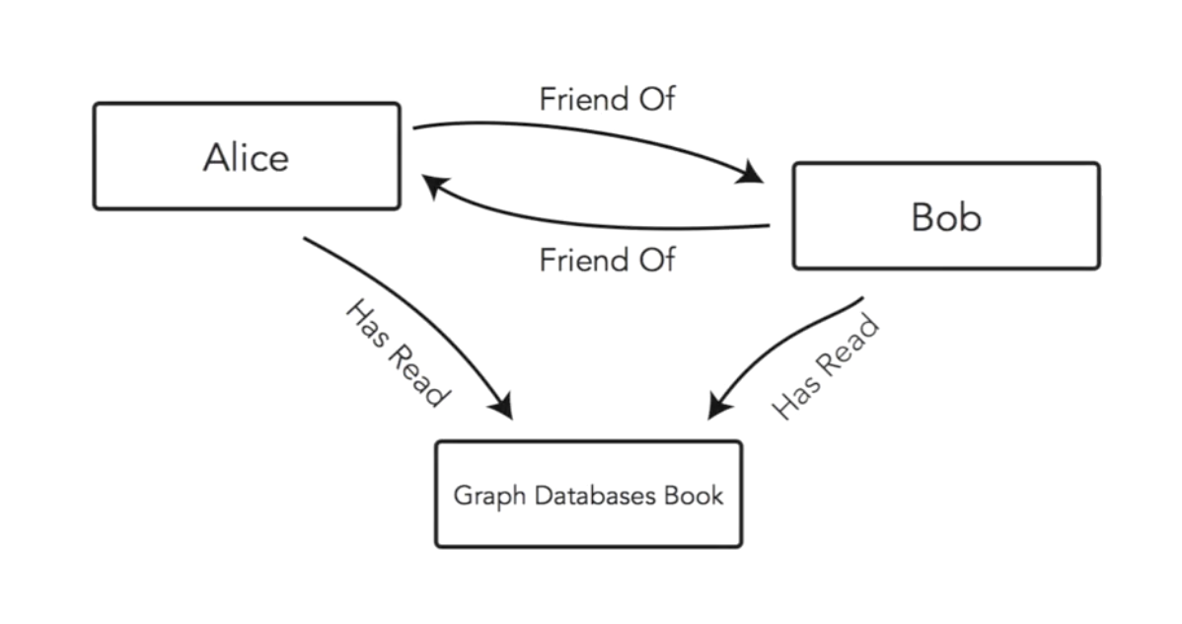

Slide 13
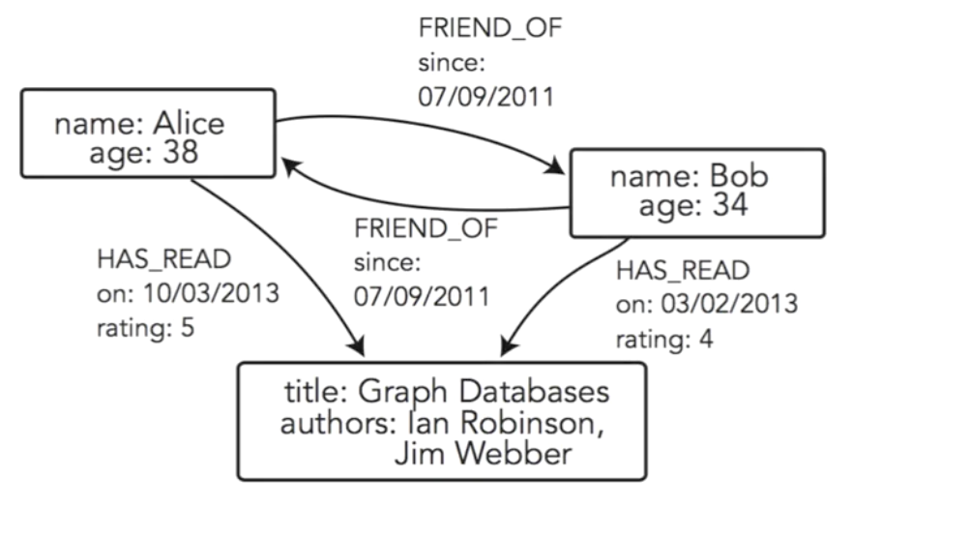

Slide 14
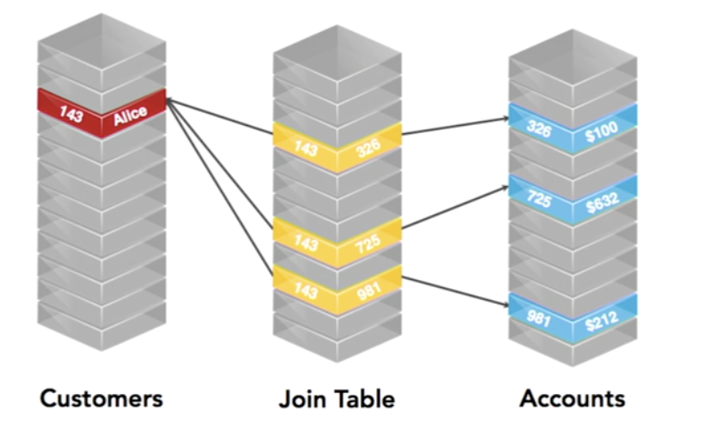

Slide 15
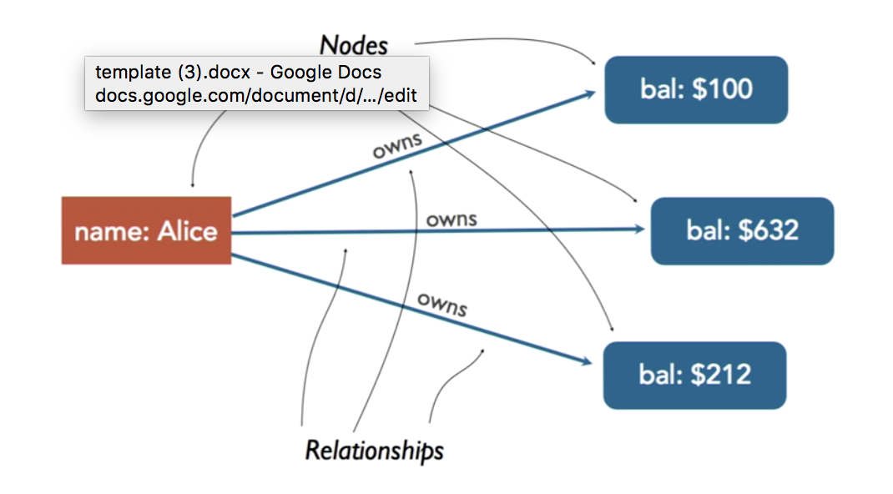

Slide 16

Companies Using Neo4j

Slide 17
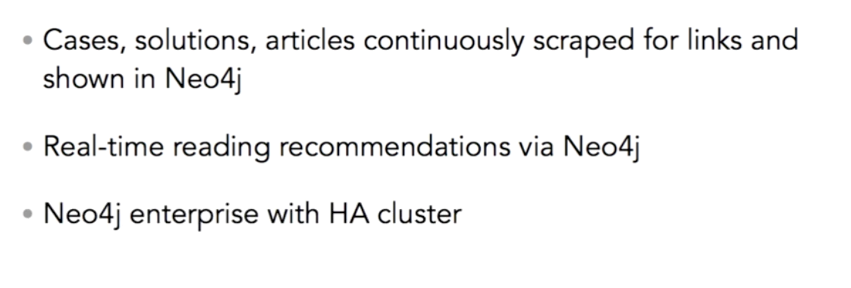
Cisco

Slide 18
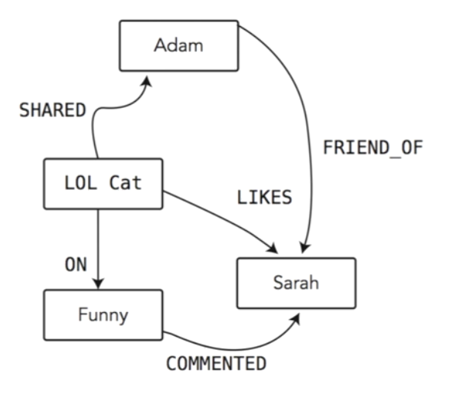
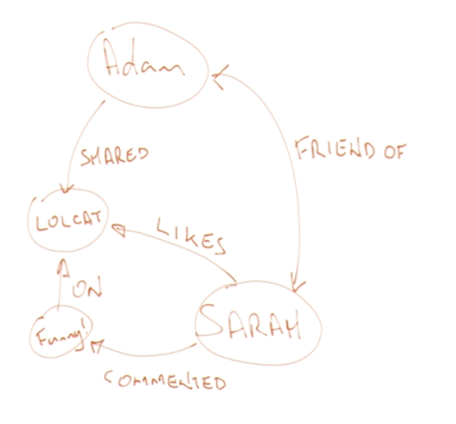
Start Building Graphs

Slide 19
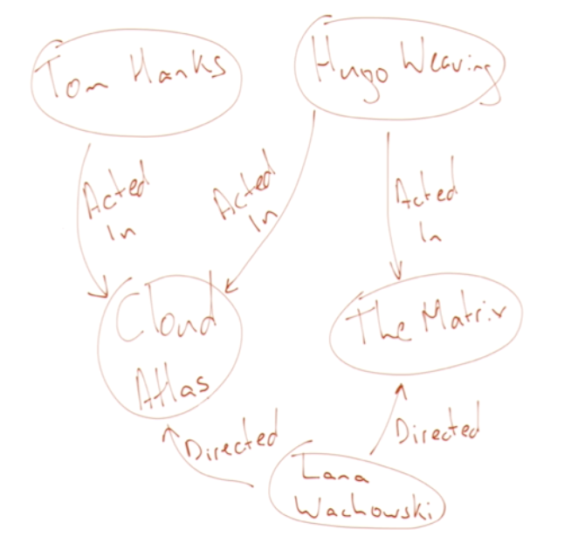
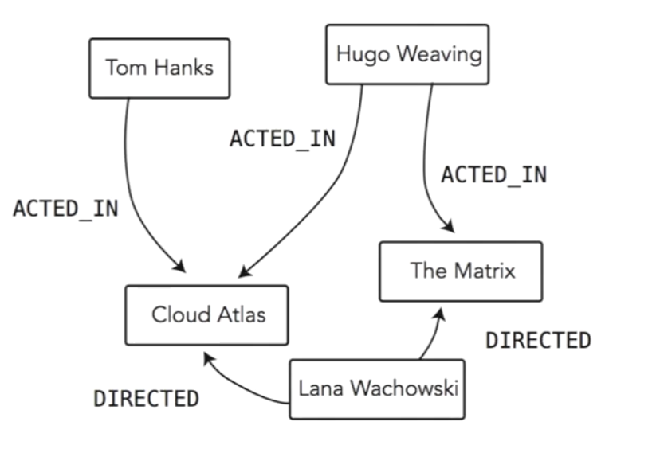

Slide 20
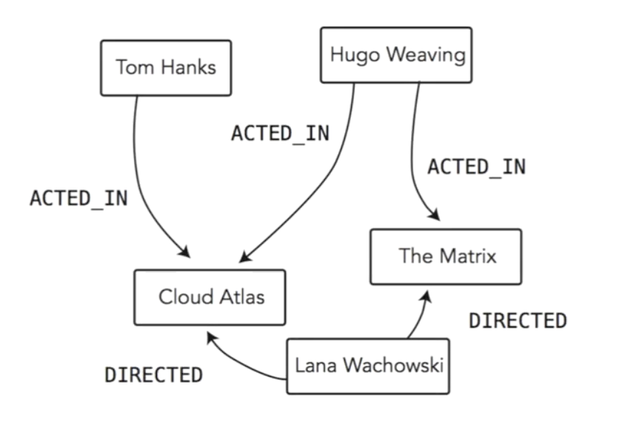
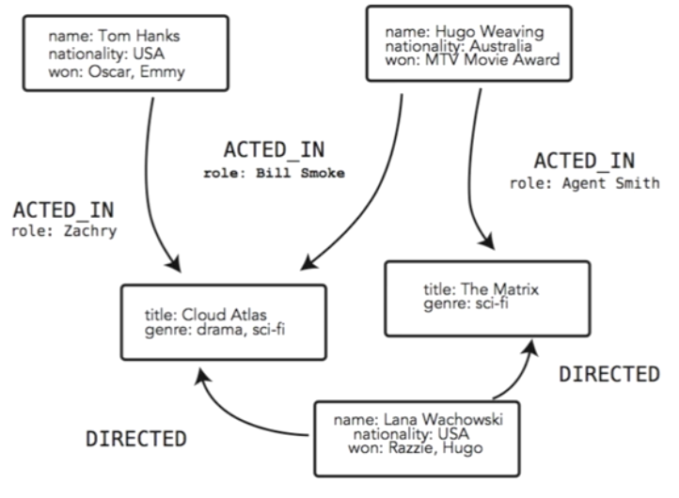
Model Incrementally

Slide 21
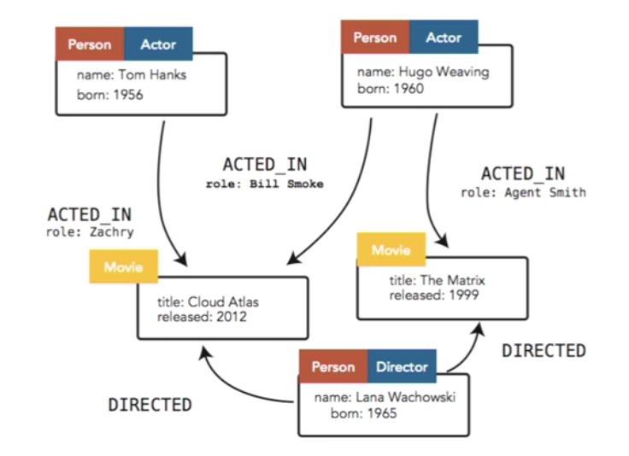
New in Neo4j 2.0

Slide 22
Exploring the web console
https://neo4j.com/sandbox-v2/#

Slide 23


Slide 24
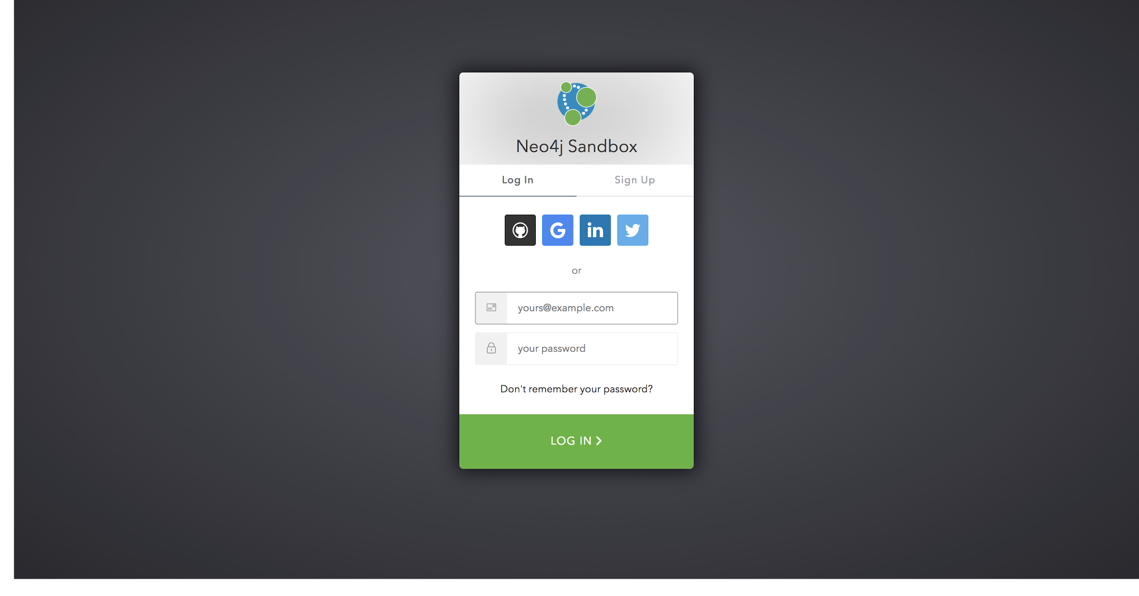

Slide 25
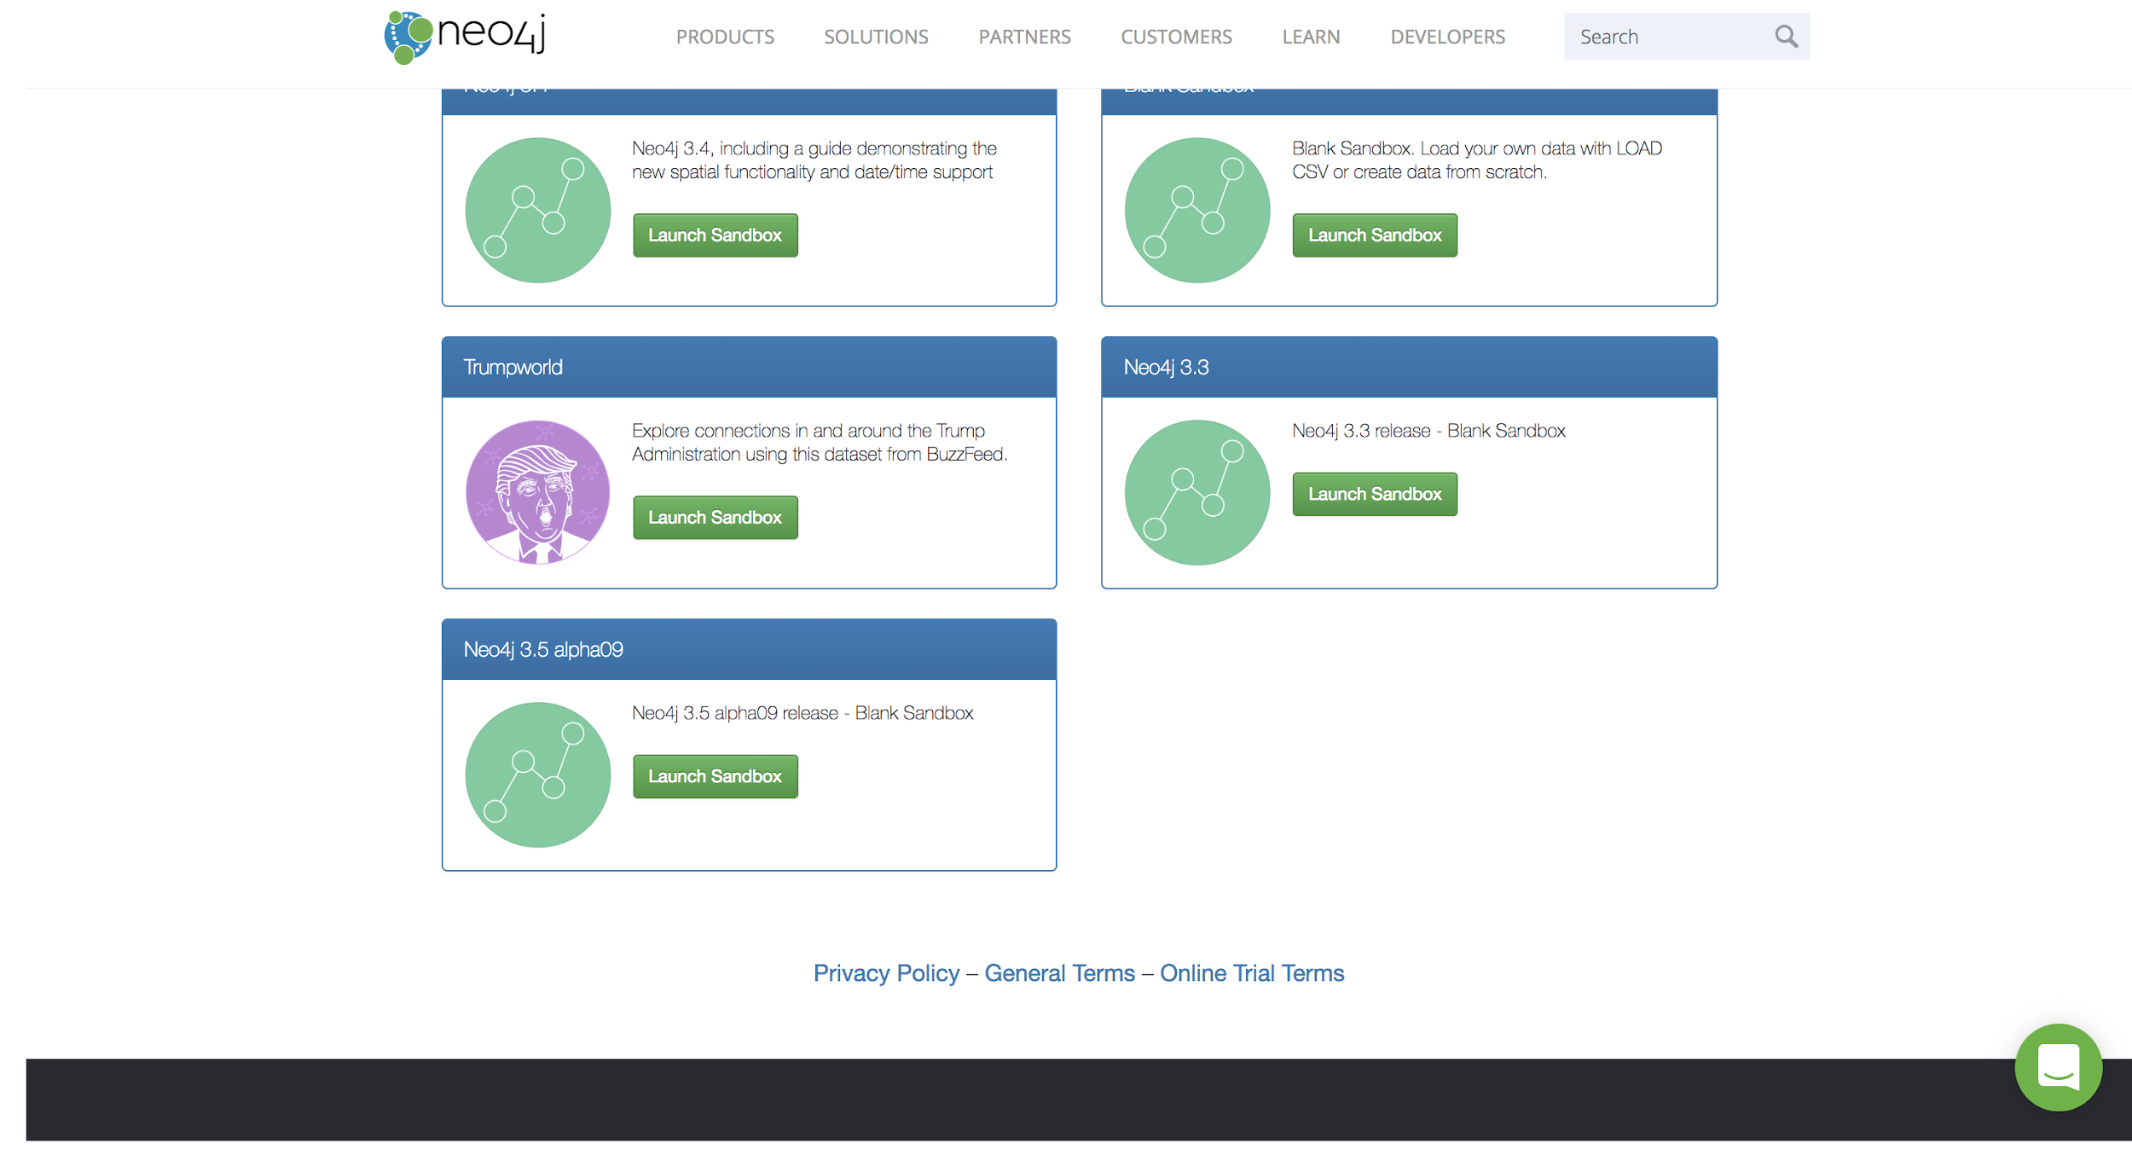

Slide 26
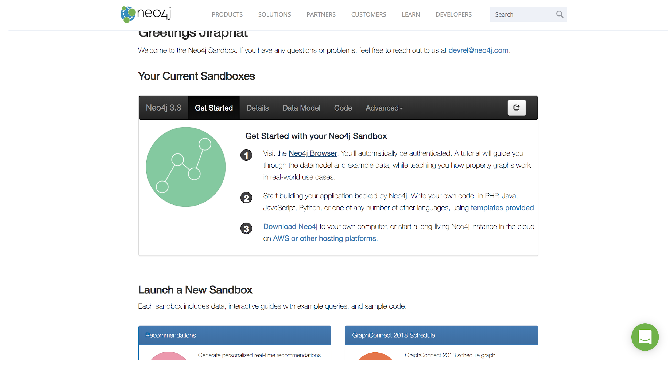

Slide 27
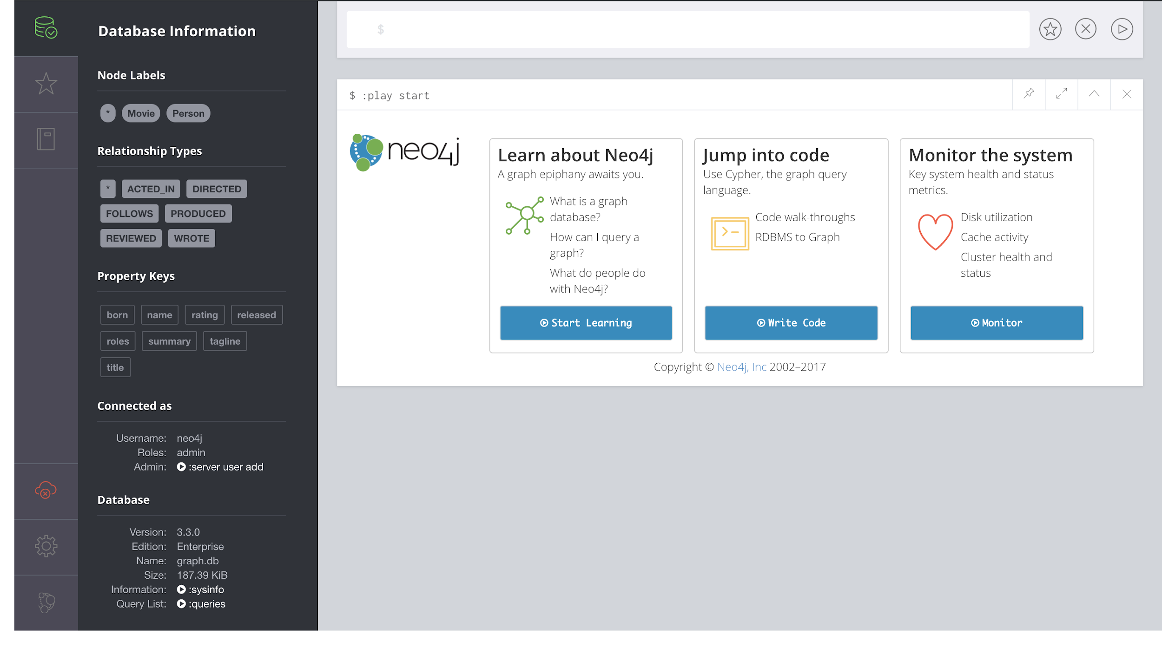

Slide 28
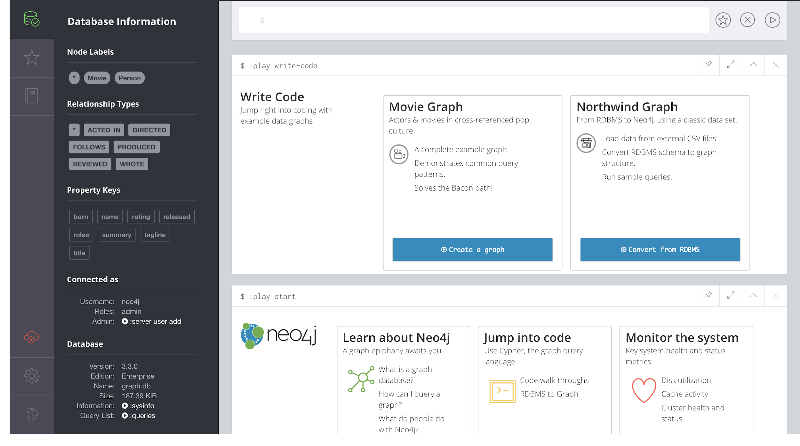

Slide 29
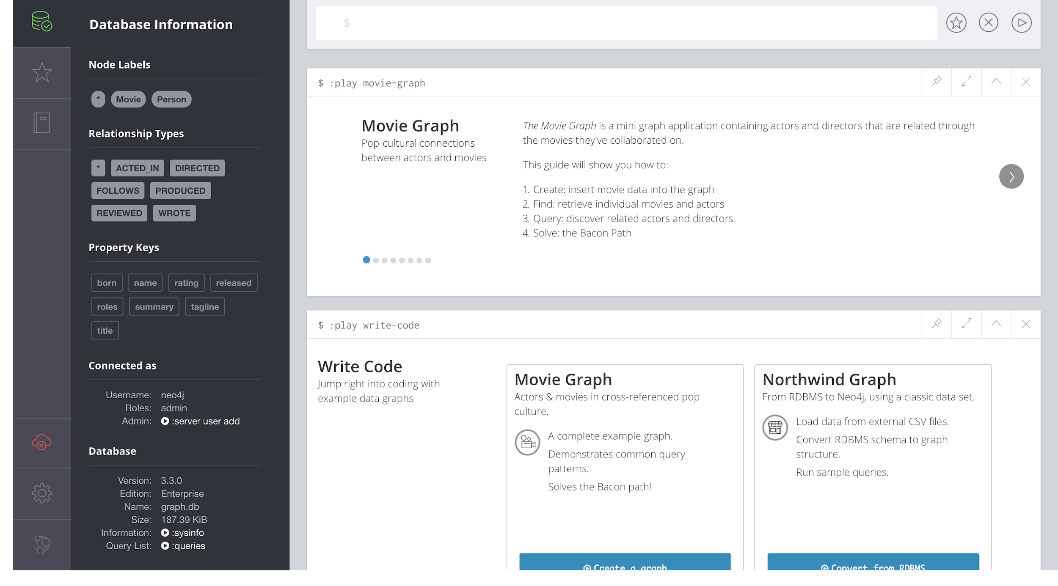

Slide 30
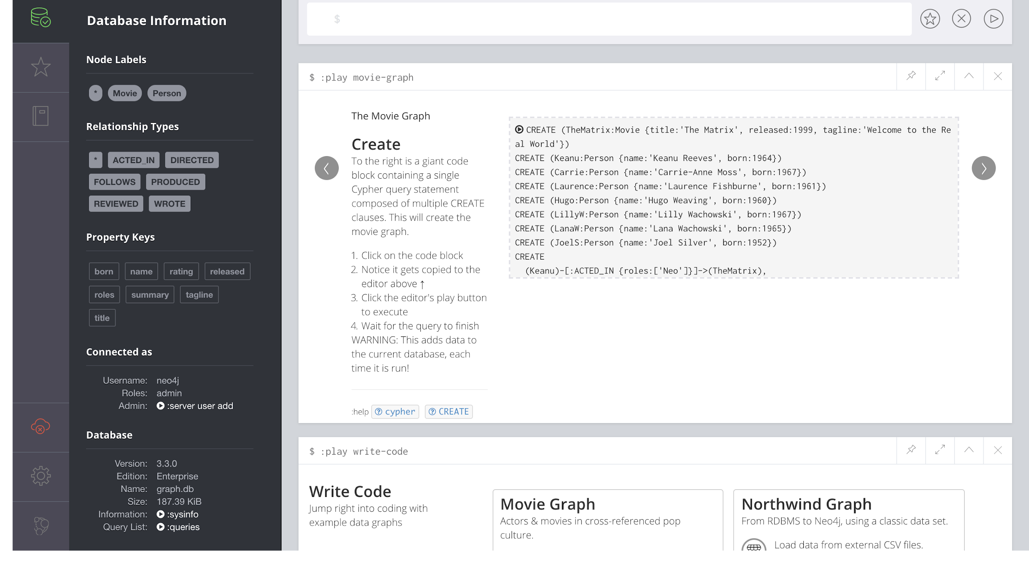

Slide 31
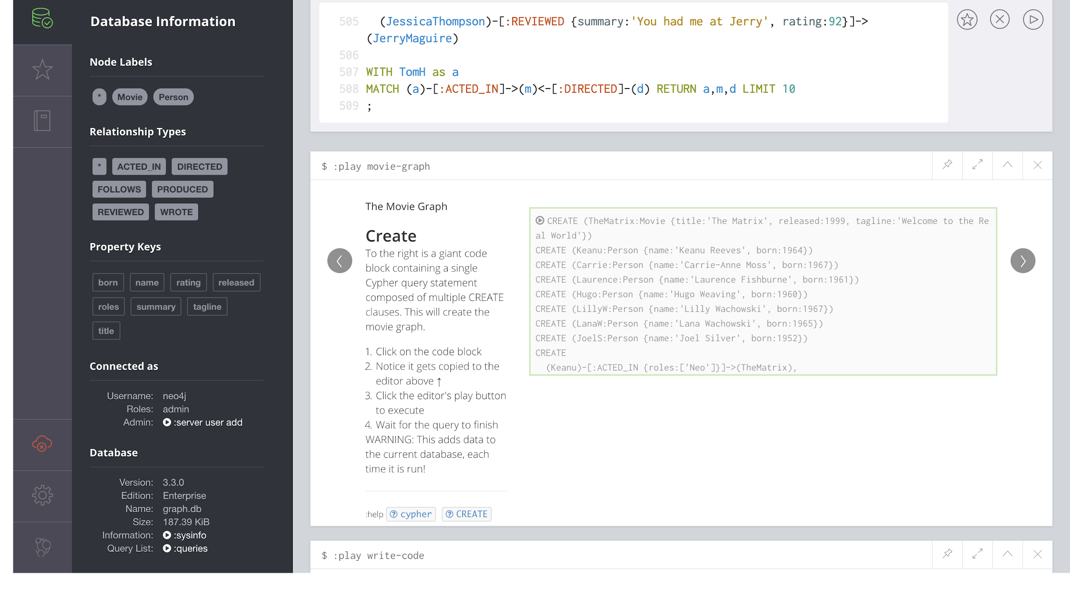

Slide 32
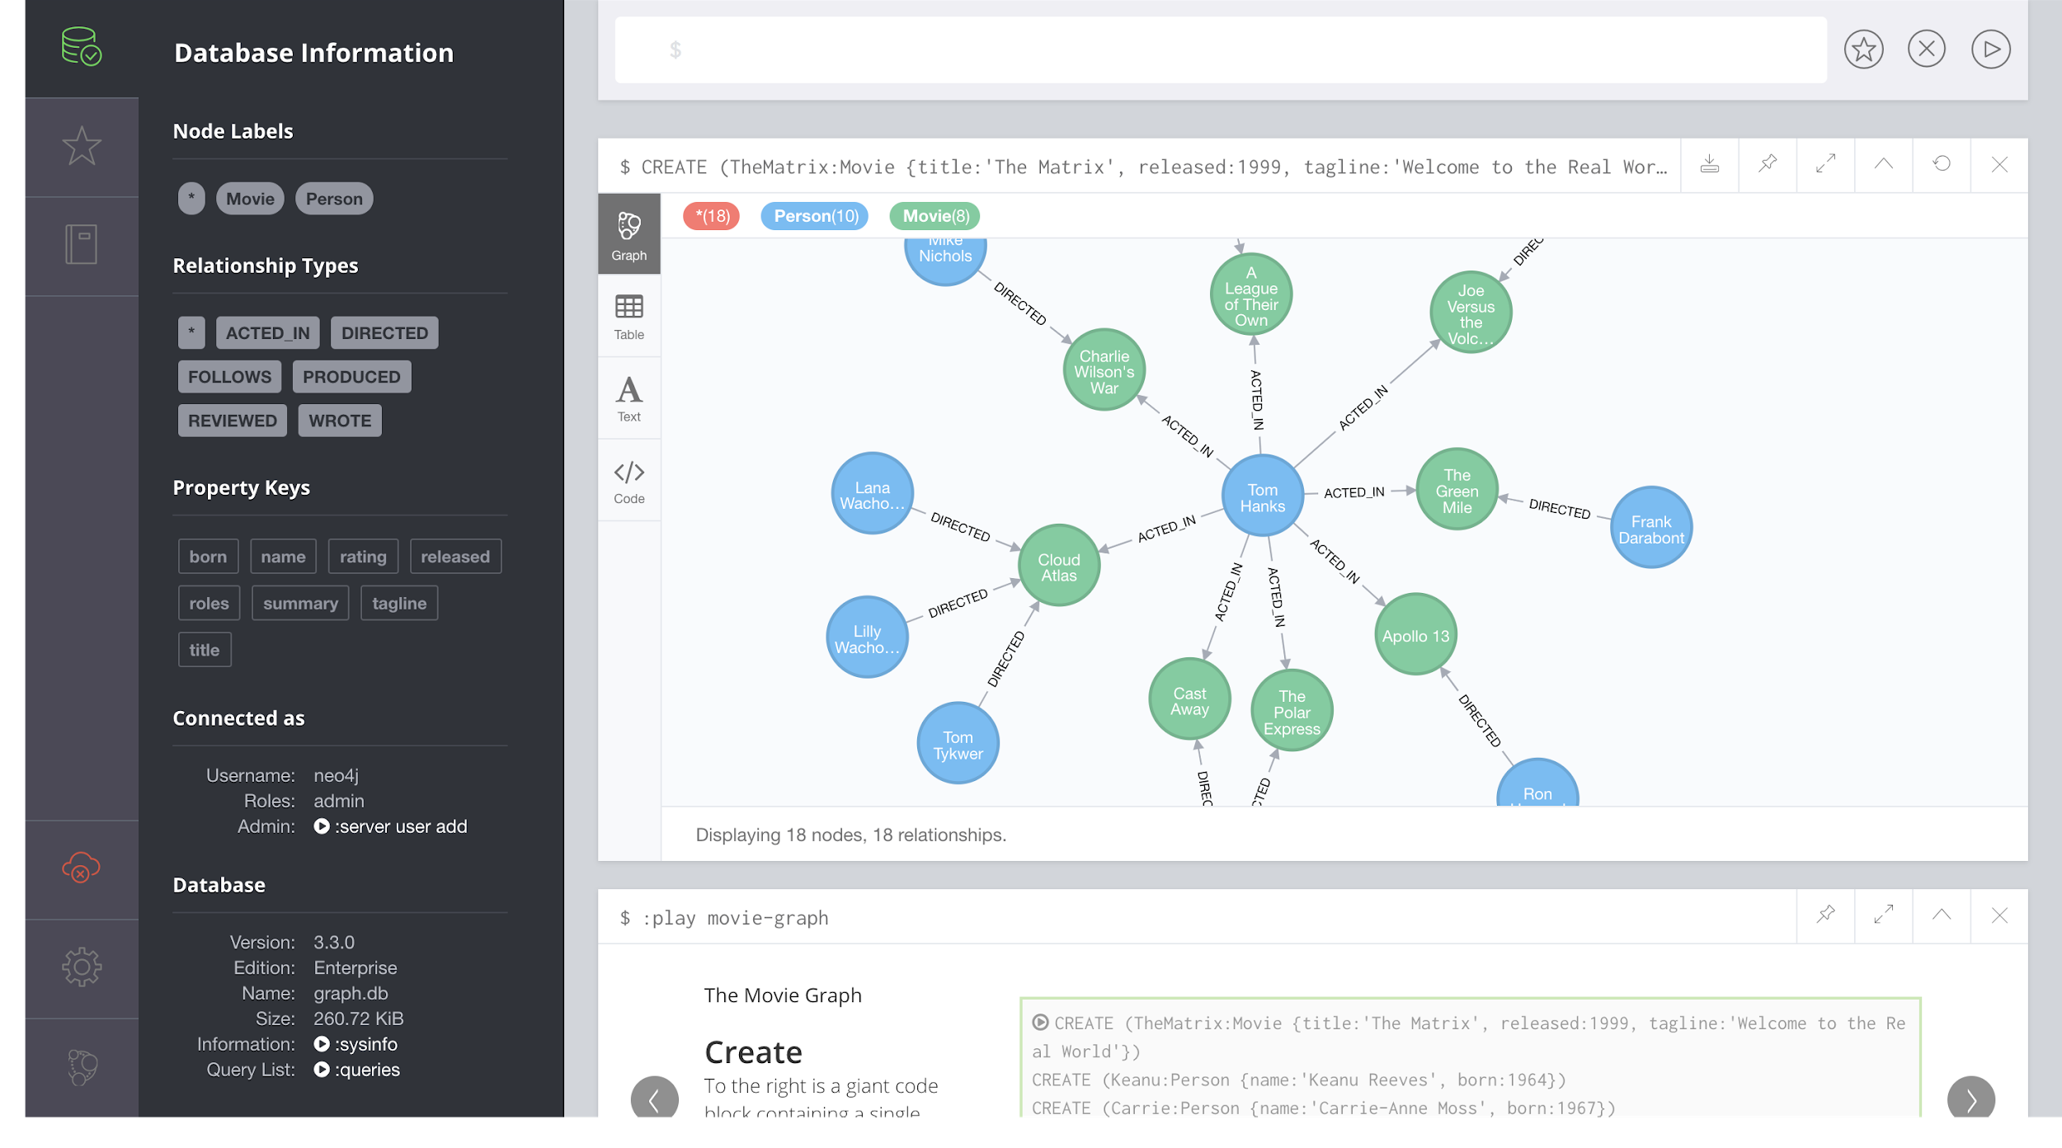

Slide 33
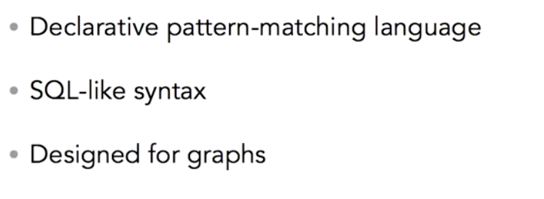
Cypher is Neo4j’s Graph Query Language

Slide 34
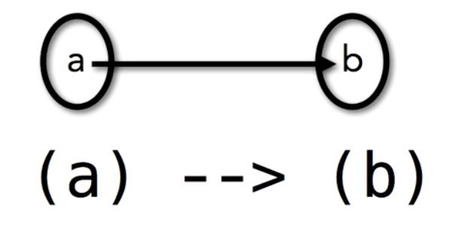
Two Nodes, One Relationship

Slide 35
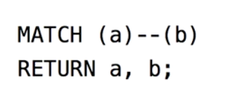
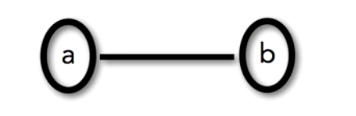
Two Nodes, One Relationship

Slide 36


Slide 37
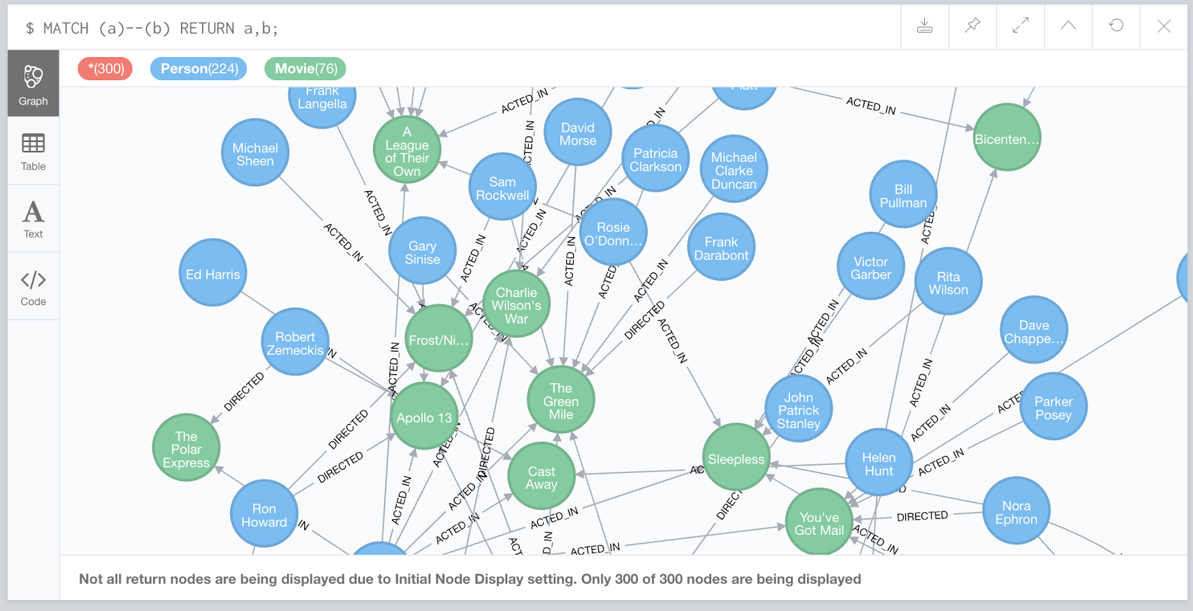

Slide 38
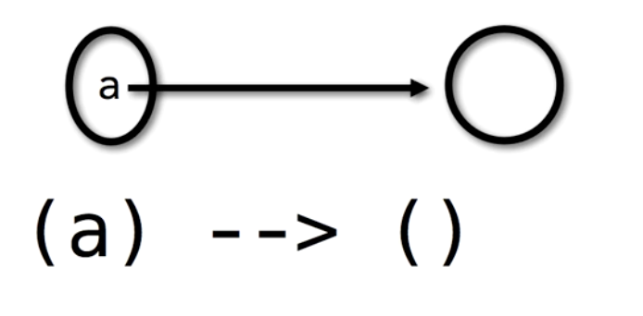
Two Nodes, One Relationship

Slide 39
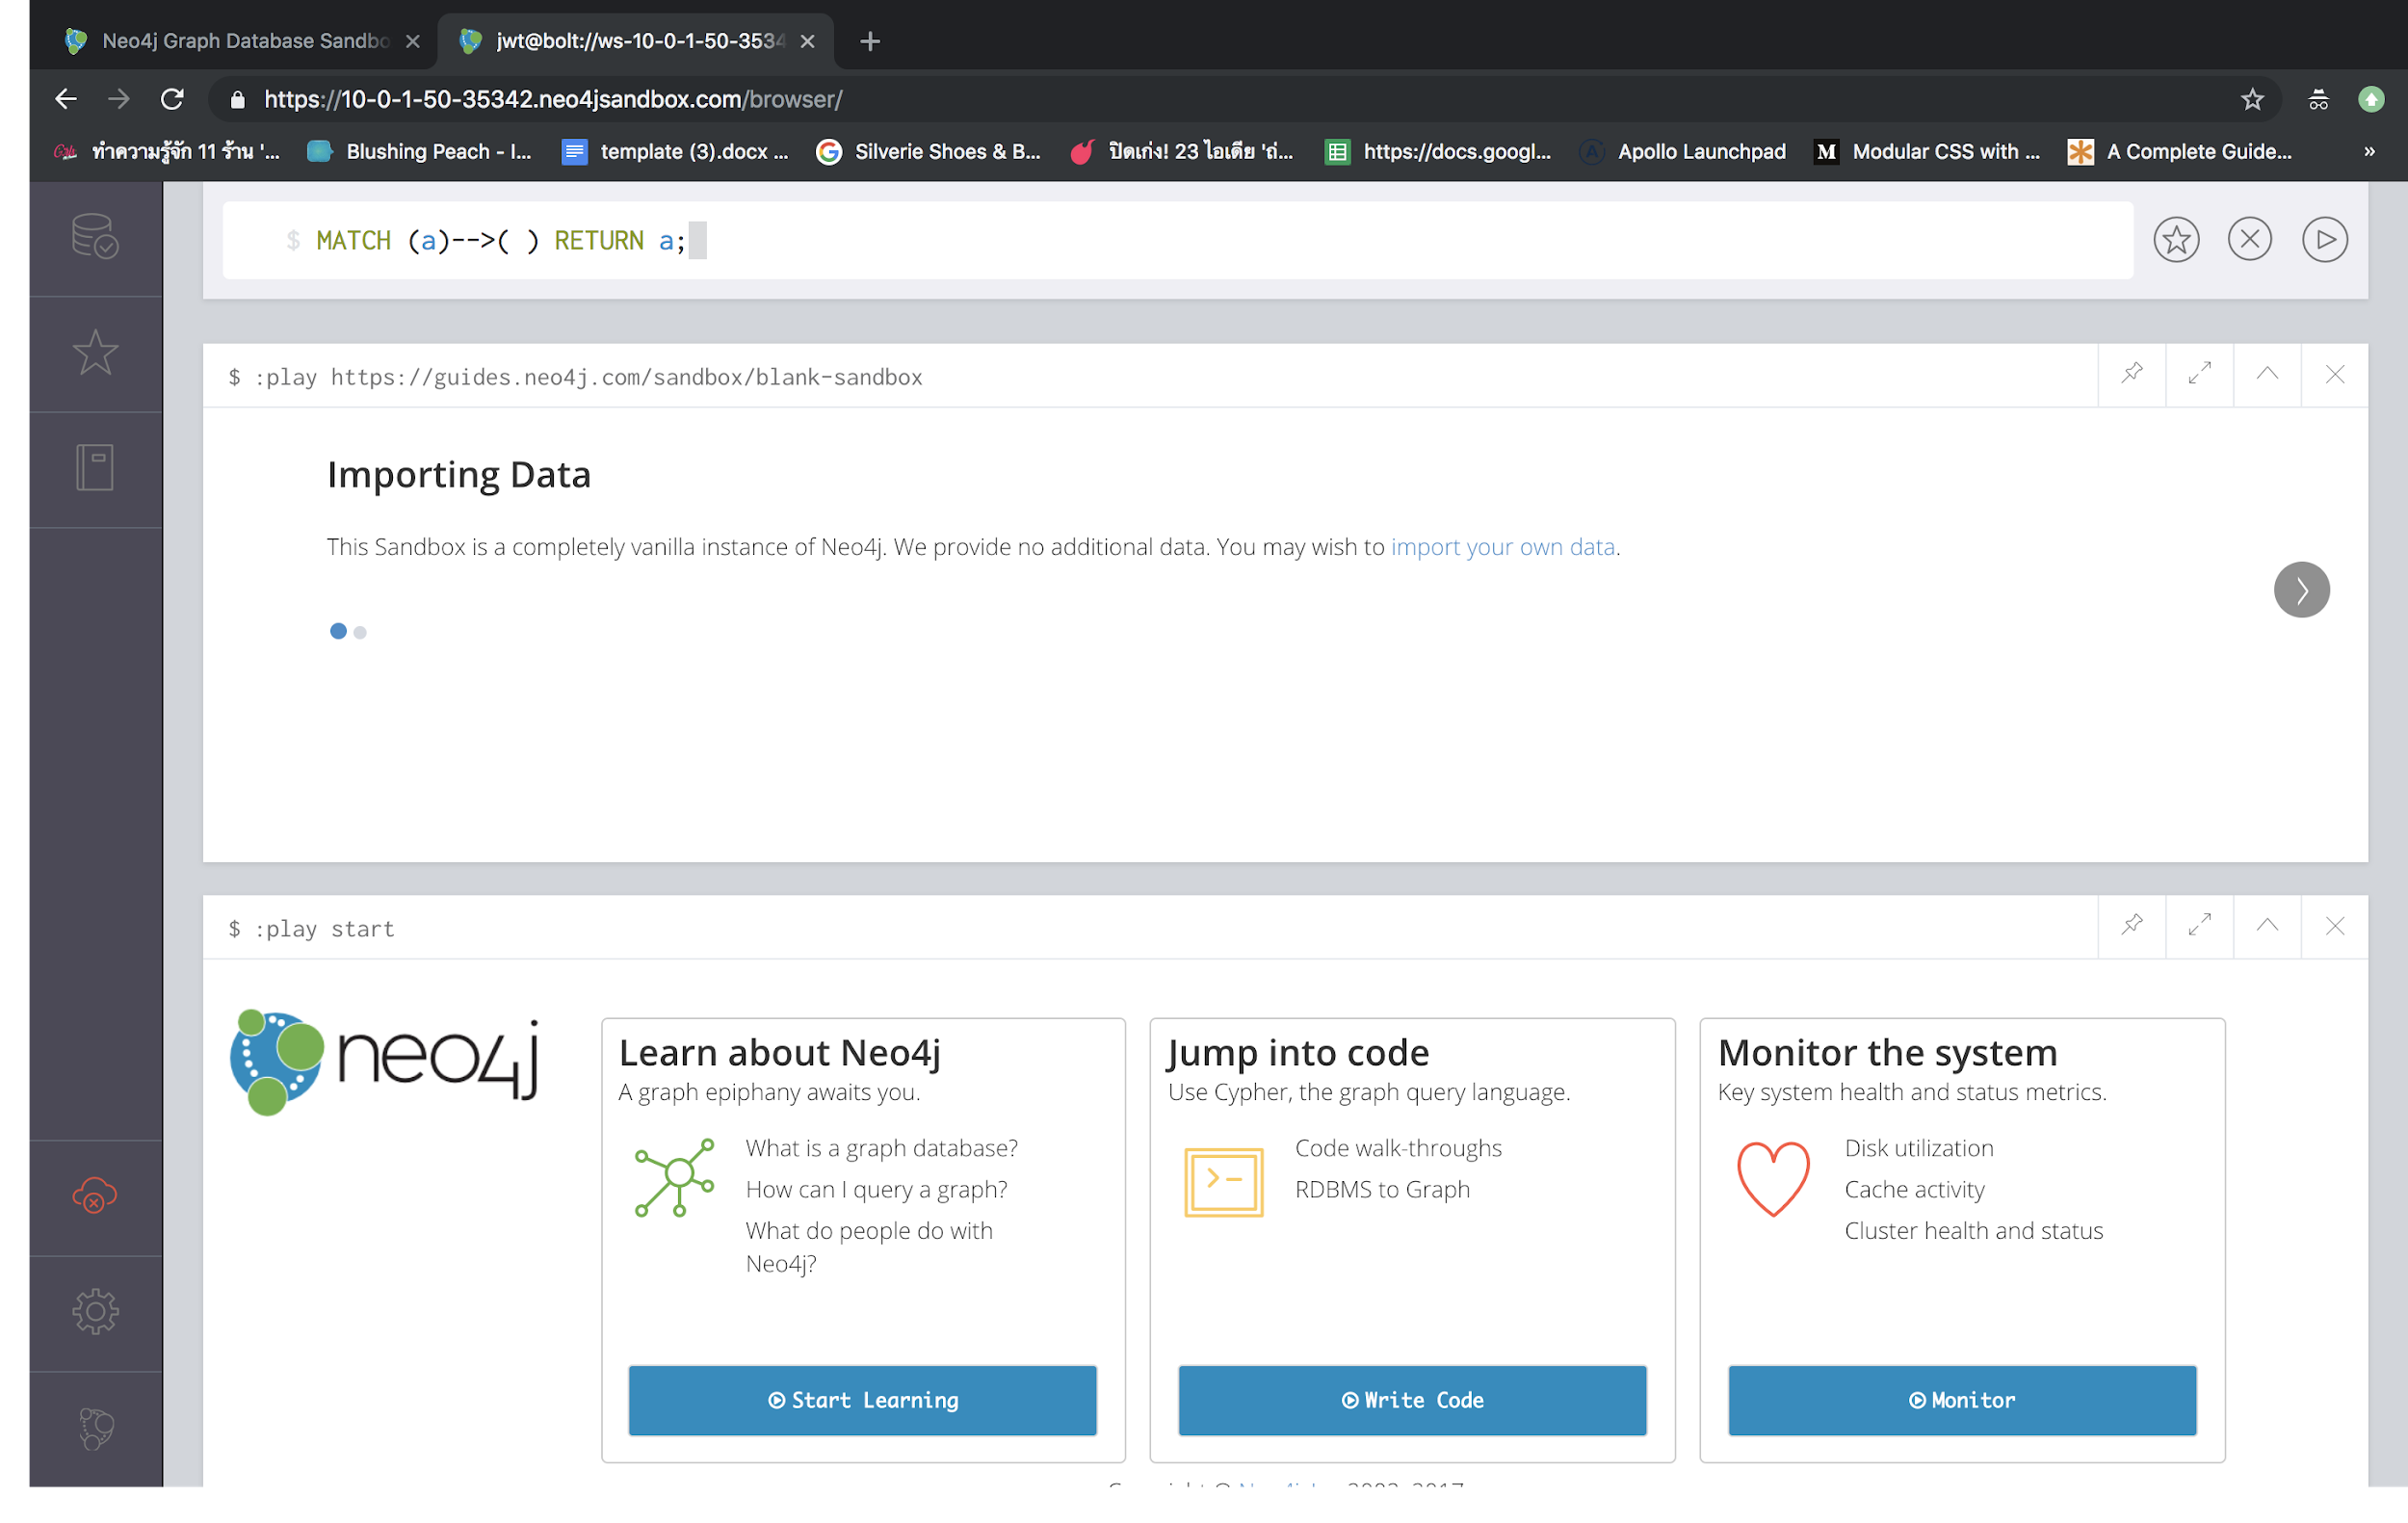

Slide 40
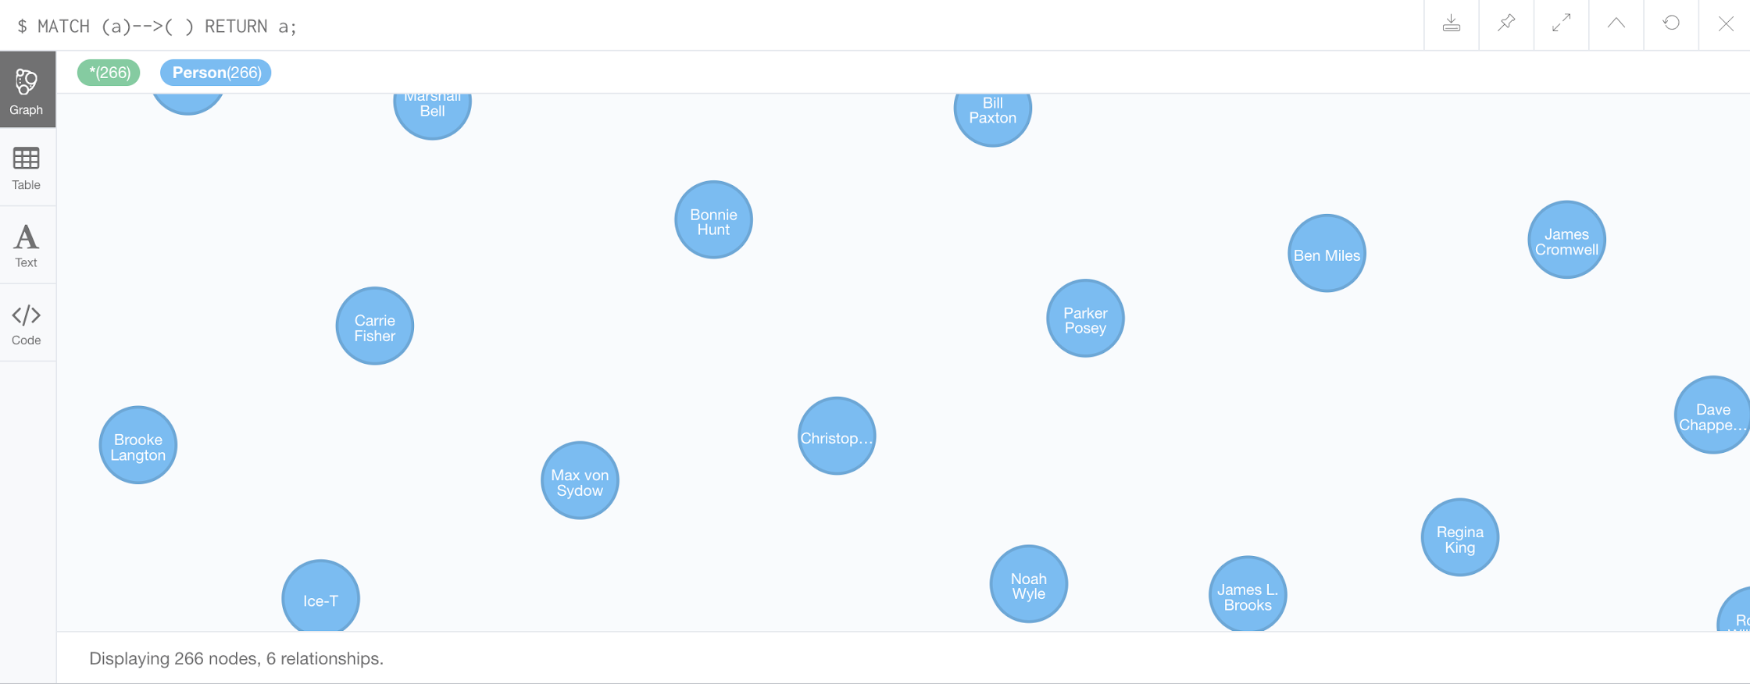

Slide 42
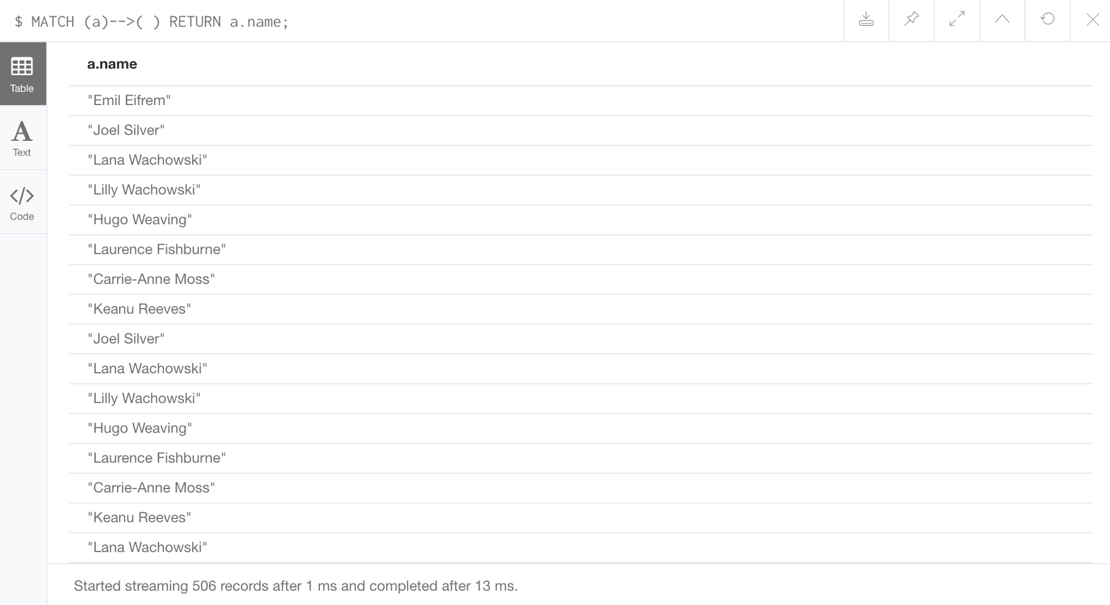

Slide 43
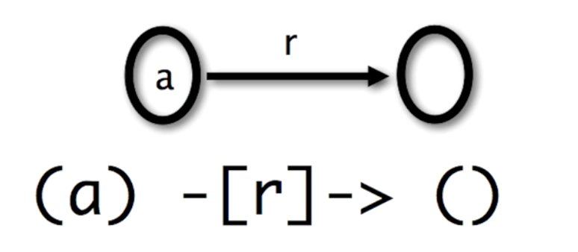
Two Nodes, One Relationship

Slide 44
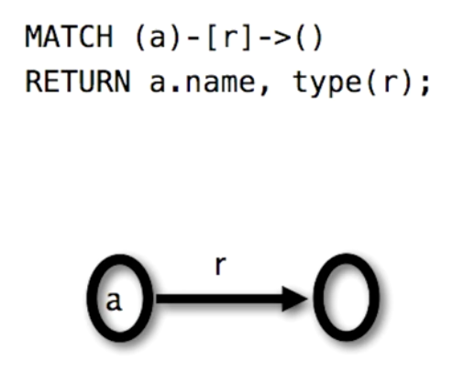
Two Nodes, One Relationship

Slide 45
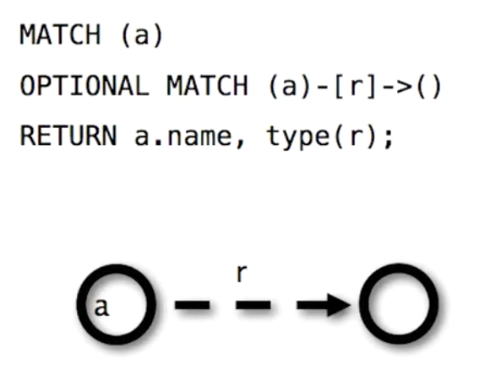
Two Nodes, One Relationship

Slide 46
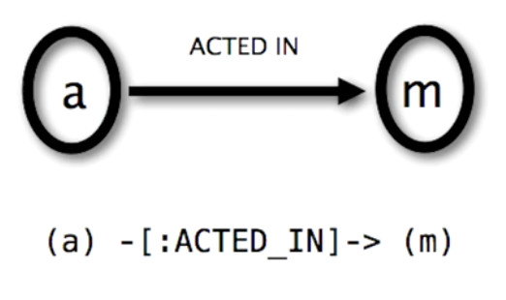
Two Nodes, One Relationship

Slide 47
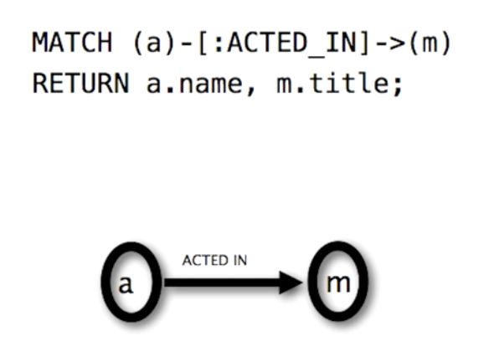
Two Nodes, One Relationship

Slide 48
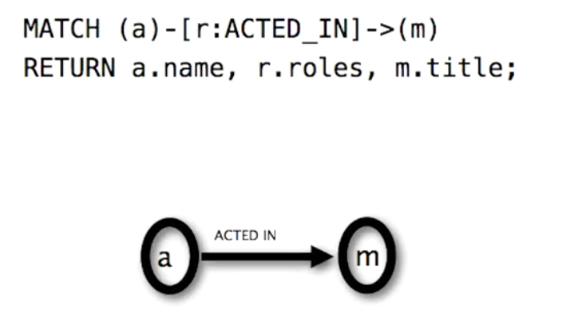
Two Nodes, One Relationship

Slide 49
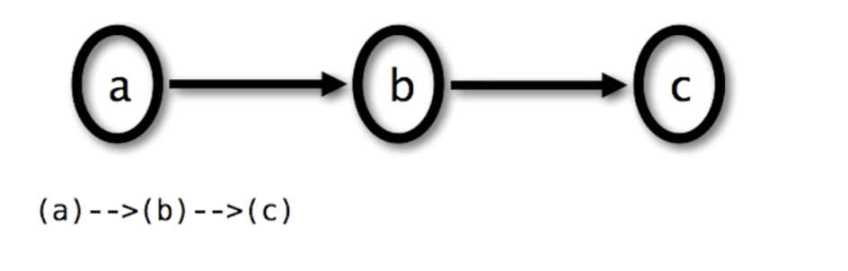
Paths

Slide 50
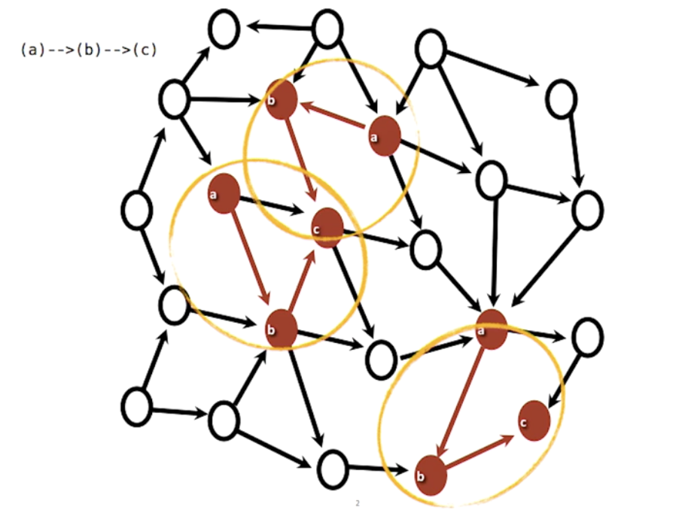

Slide 51
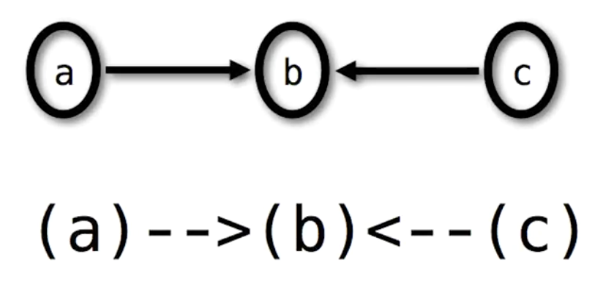
Paths

Slide 52
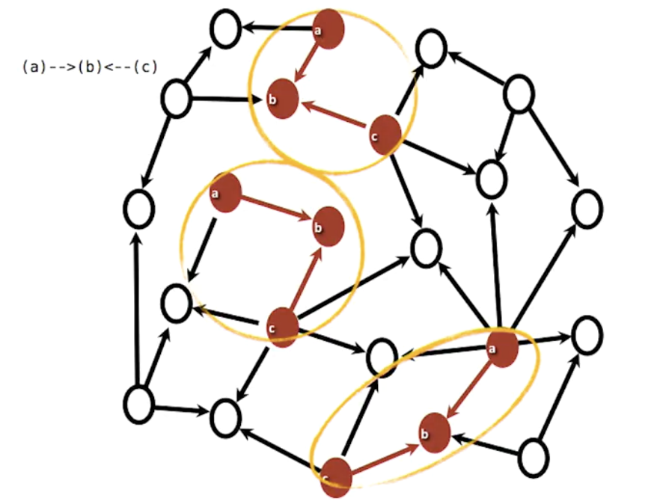

Slide 53
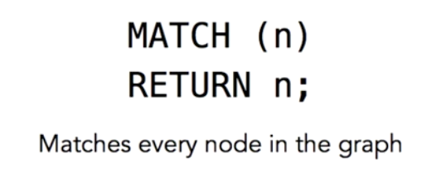
All-Nodes Query

Slide 54
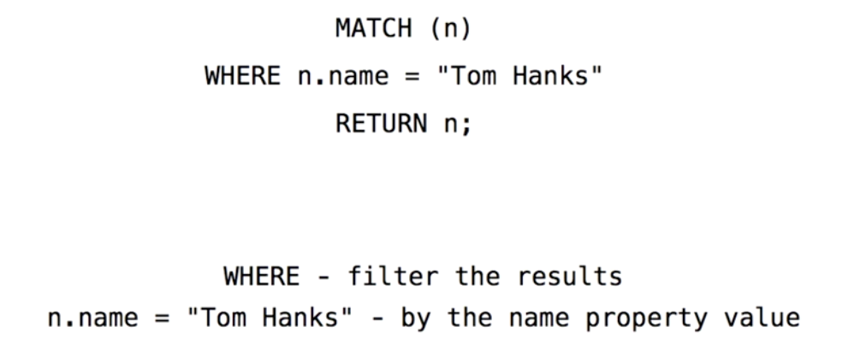
Find a Specific Node (Within all nodes)

Slide 55
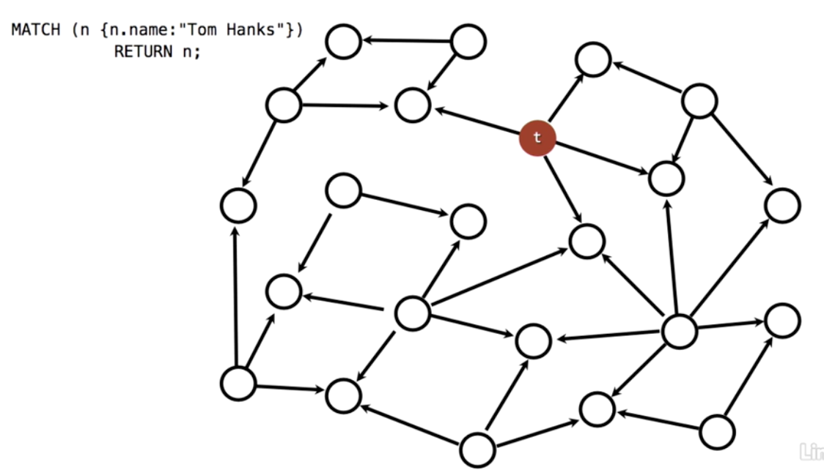

Slide 56

Find a Specific Node (with a label)

Slide 57


Slide 58


Working with labeled nodes

Slide 59


Slide 60

Create label-specific index

Slide 61

Labels on pattern “anchors”

Slide 62


Slide 63
CREATE NODE
CREATE (A:Person {name:'AAAA', born:1990})
CREATE (B:Person {name:'BBBB', born:1991})
CREATE (A)-[:FRIEND_WITH]->(B);
MATCH (B:Person)
WHERE B.name = 'BBBB'
CREATE (C:Person {name:'CCCC', born:1992})
CREATE (C)-[f:FRIEND_WITH] -> (B)
RETURN C, f, B;

Slide 64
DELETE NODE
MATCH (n)
DETACH DELETE n;

